Slide 1



AirBnb Analysis
View in Power BI
Last data refresh:
2/22/2024 7:19:41 PM UTC
Downloaded at:
2/22/2024 7:42:11 PM UTC

Slide 2
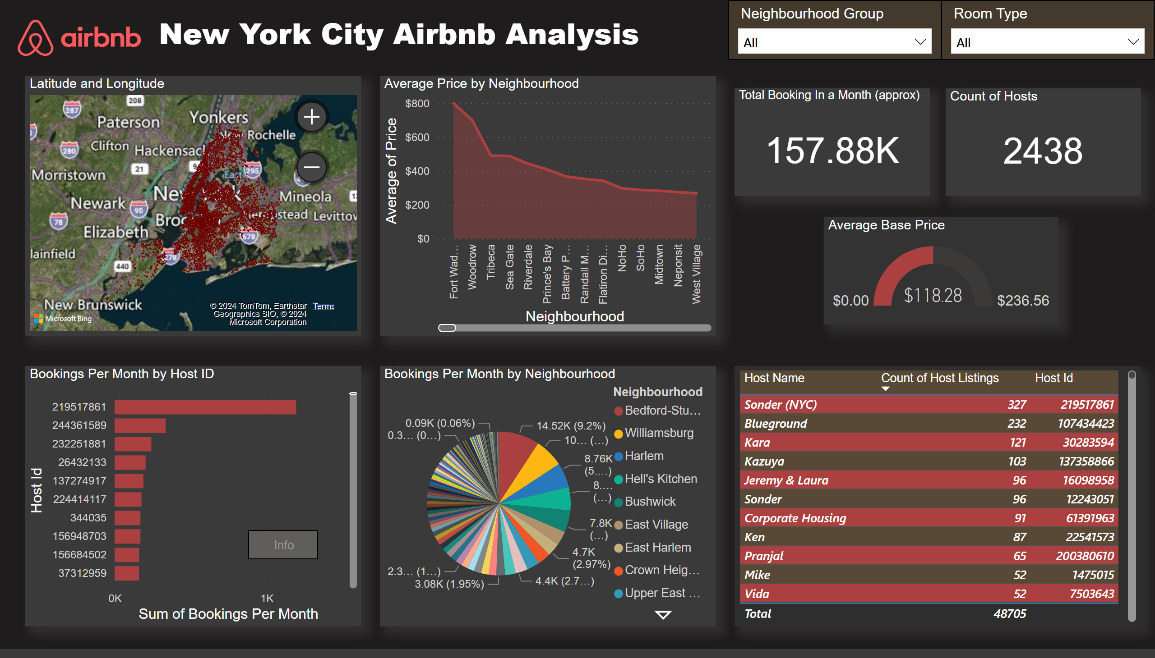
NYC Airbnb Analysis
Notes:
tableEx
No alt text provided
map
No alt text provided
Count of Hosts
No alt text provided
slicer
No alt text provided
Average Base Price
No alt text provided
slicer
No alt text provided
Average Price by Neighbourhood
No alt text provided
Total Booking In a Month (approx)
No alt text provided
Bookings Per Month by Host ID
No alt text provided
Bookings Per Month by Neighbourhood
No alt text provided
textbox
No alt text provided
actionButton
No alt text provided
image
No alt text provided

Slide 3
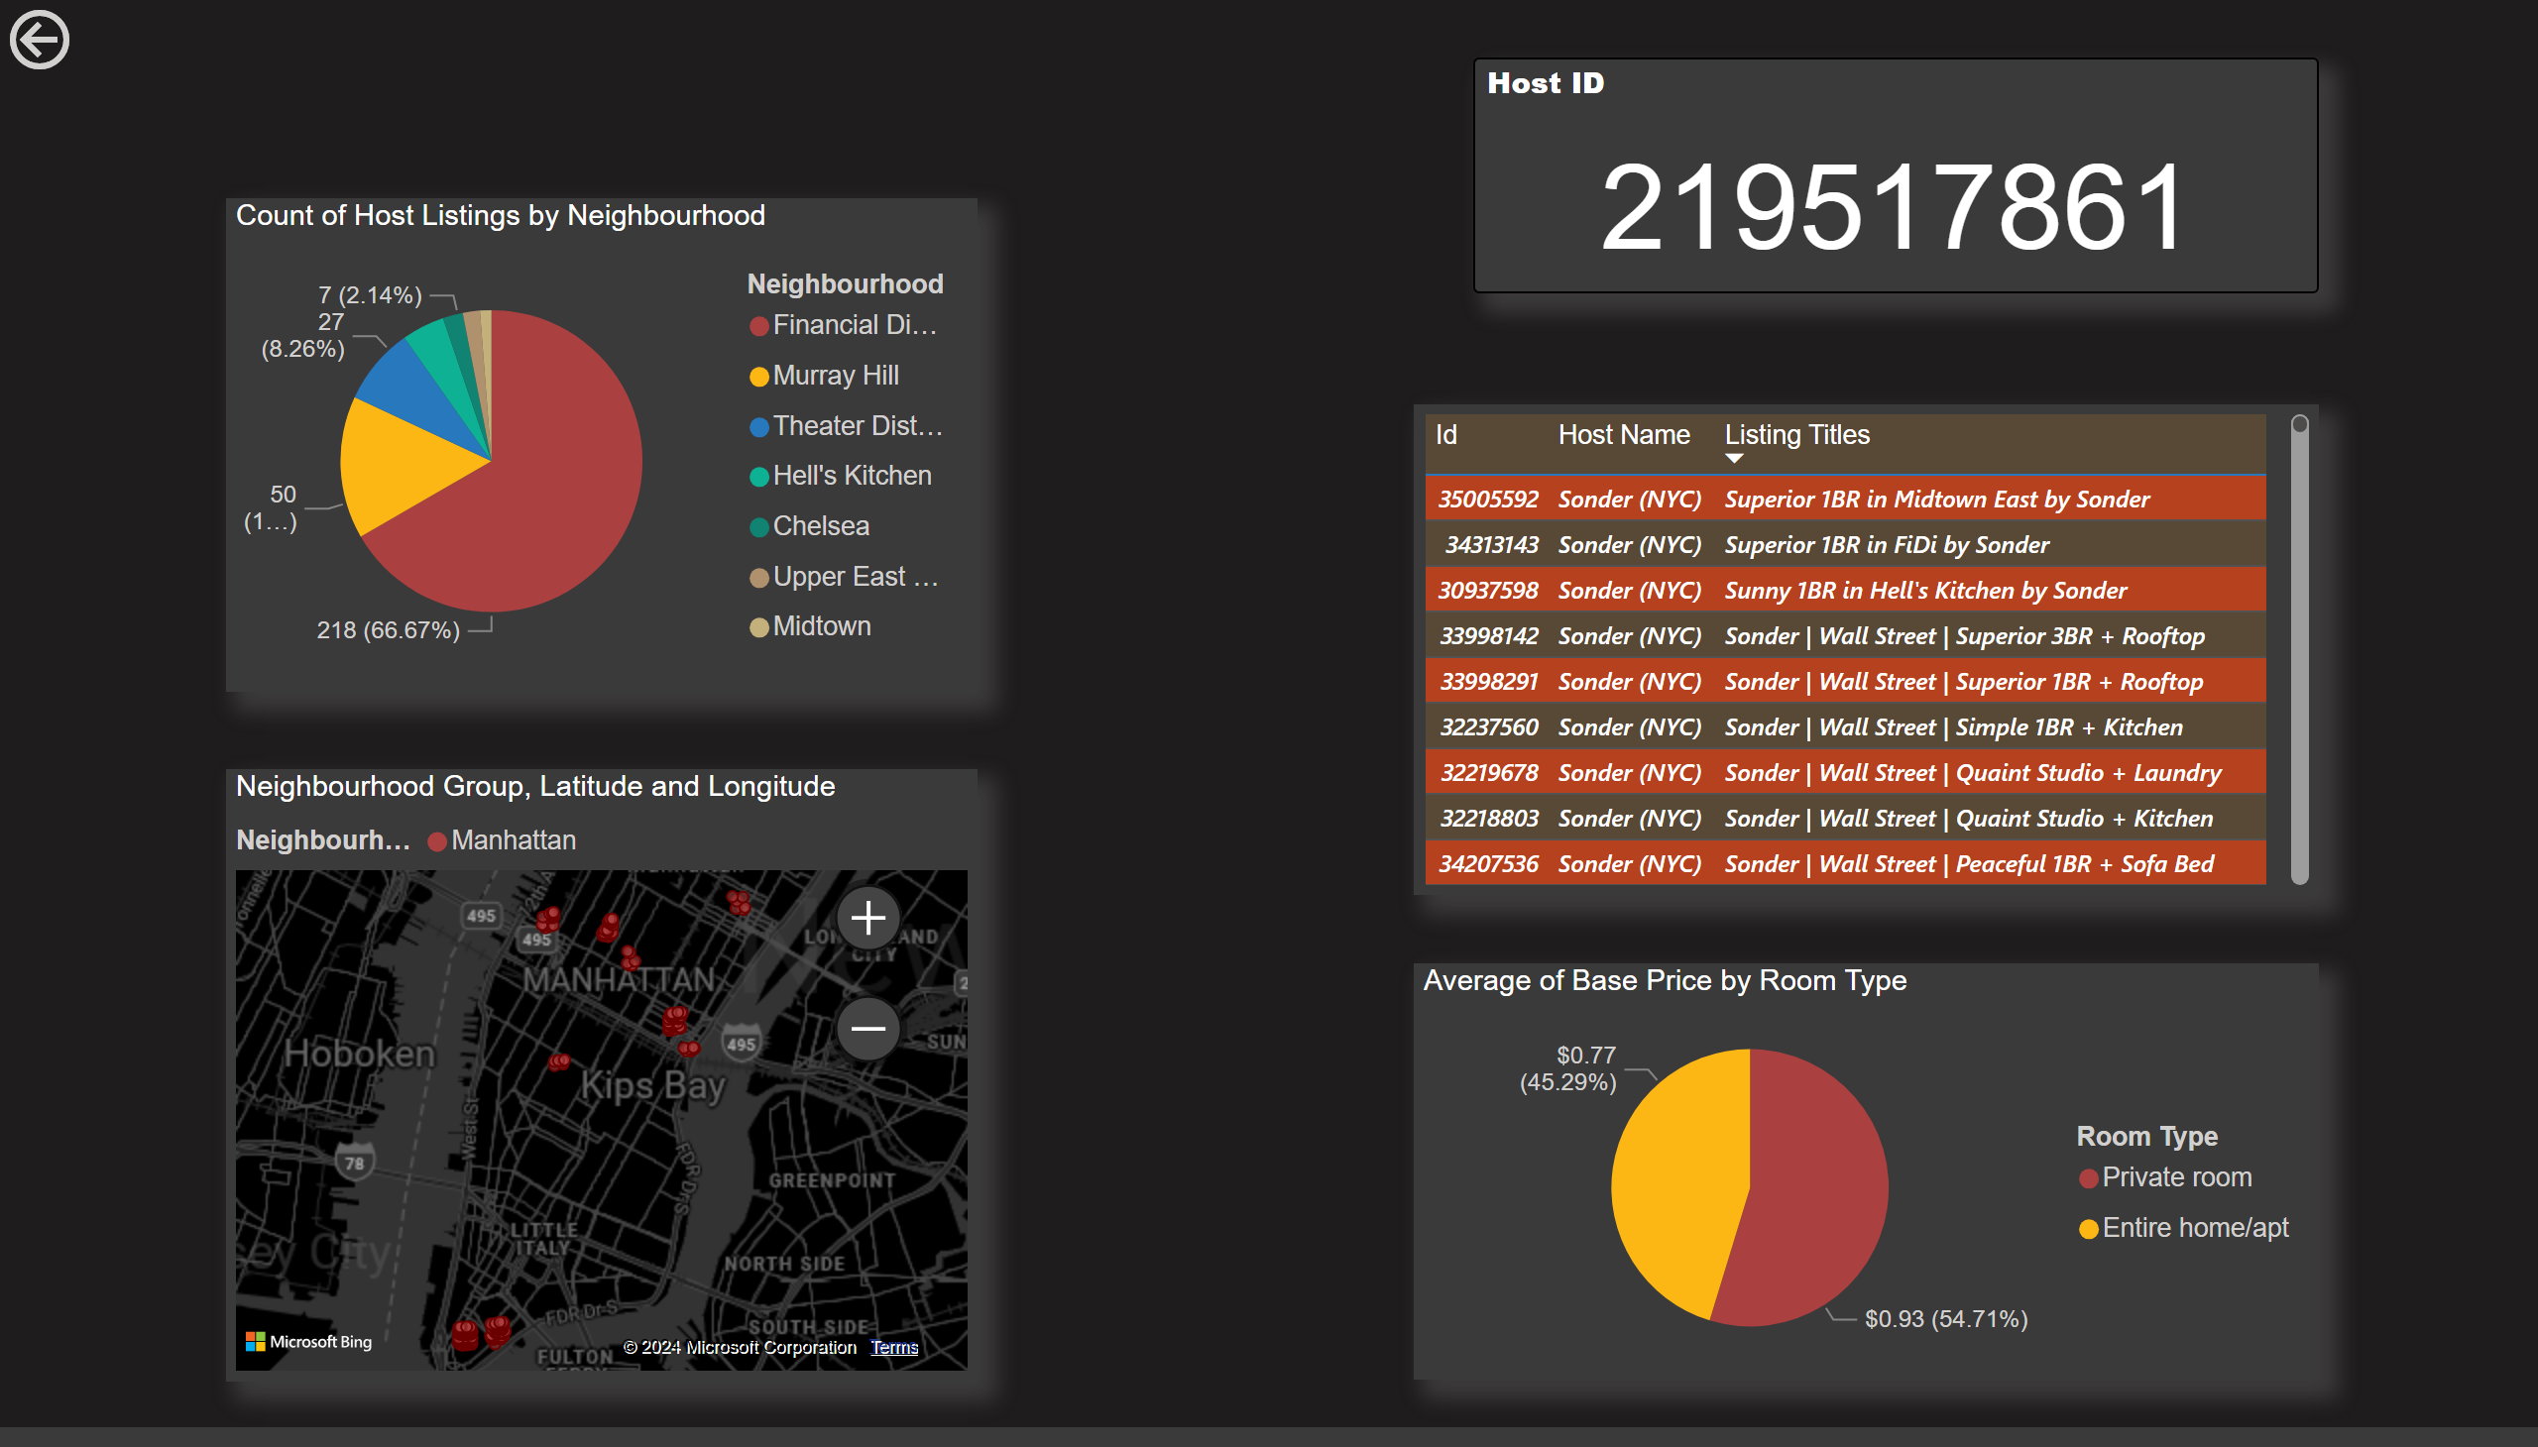
Host info
Notes:
pieChart
No alt text provided
actionButton
No alt text provided
map
No alt text provided
Host ID
No alt text provided
actionButton
No alt text provided
tableEx
No alt text provided
pieChart
No alt text provided

